Slide 1
DSI Capstone so far technical
By Alex Yi Zhou

Slide 2
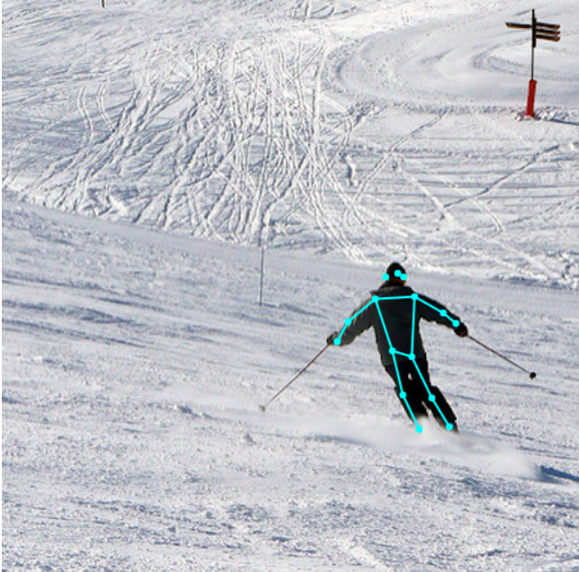
Getting key points

Slide 3
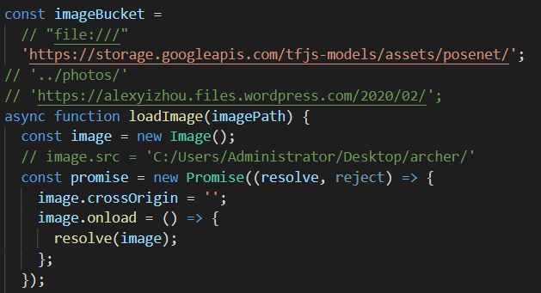
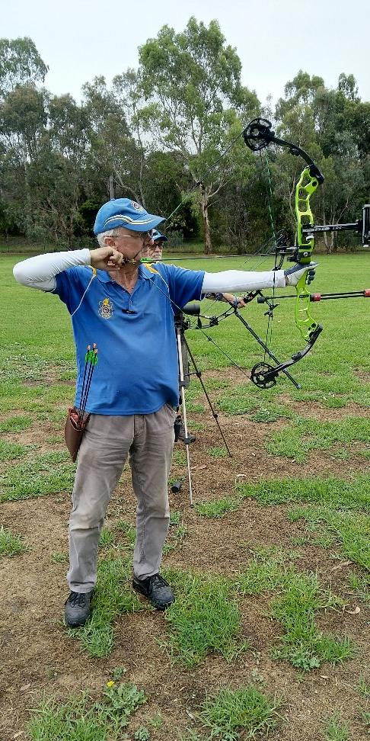
No success loading image

Slide 4
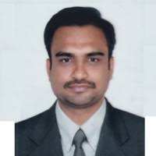
Meeting Hiren Parmar
GA Data Immersive graduate of the same batch last year

Slide 5

Lunch with Hiren

Slide 6
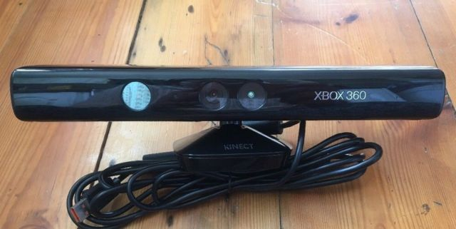
Kinect

Slide 7
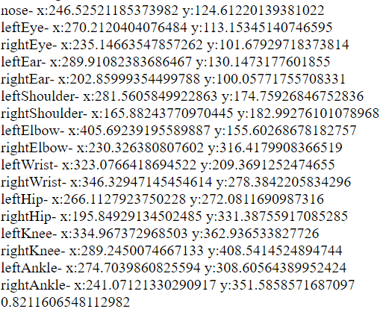
Getting body coordinates

Slide 8
Thank you for listening

